Slide 1
Data Science Introduction
03/04/2017 – Version 1.0
Michael Girardot

Slide 2


AGENDA
1
The Data Deluge
2
What is a Data Scientist ?
3
The Data Scientist Skills
4
The Scientific Method
5
The Data Science Process
6
Tools
7
Books
La force de l’engagement^{MD}
Notes:
2

Slide 3
The Data Deluge
Hilbert, M. & Lopez, P. Science 2011
CDs per Person
1
4
12
61
1989
1993
2000
2007

Slide 4
AGENDA
1
The Data Deluge
2
What is a Data Scientist ?
3
The Data Scientist Skills
4
The Scientific Method
5
The Data Science Process
6
Tools
7
Books
La force de l’engagement^{MD}
Notes:
4

Slide 5

What is a Data Scientist ?
Money ball (2011)

Slide 6
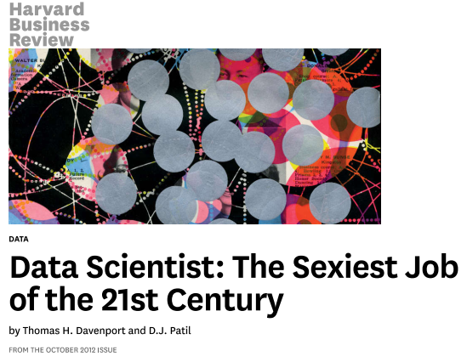
What is a Data Scientist ?
data scientist is "a new breed“
"shortage of data scientists is becoming a serious constraint in some sectors"

Slide 7
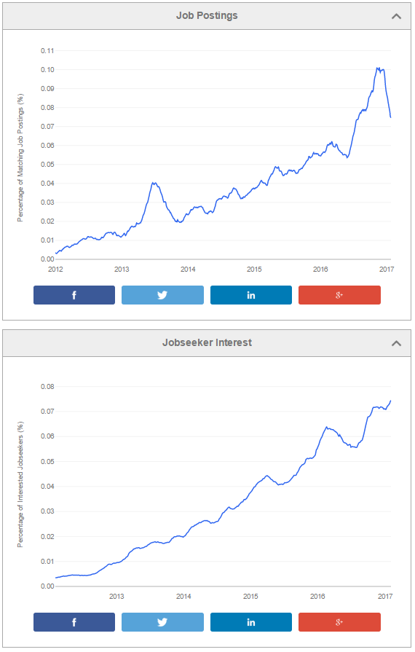

What is a Data Scientist ?
Data Scientist

Slide 8
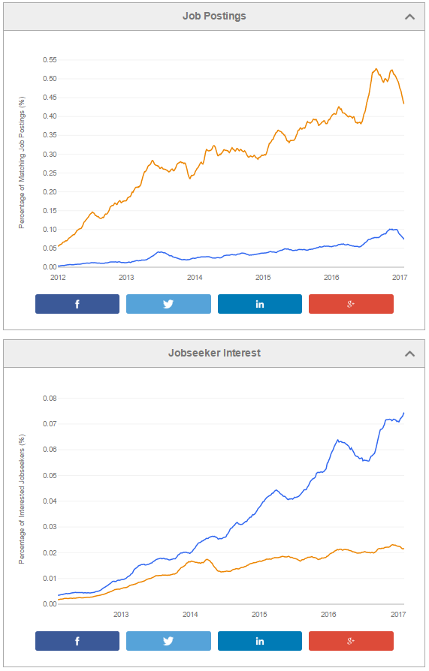
What is a Data Scientist ?
Data Scientist
Big Data

Slide 9
AGENDA
1
The Data Deluge
2
What is a Data Scientist ?
3
The Data Scientist Skills
4
The Scientific Method
5
The Data Science Process
6
Tools
7
Books
La force de l’engagement^{MD}
Notes:
9

Slide 10
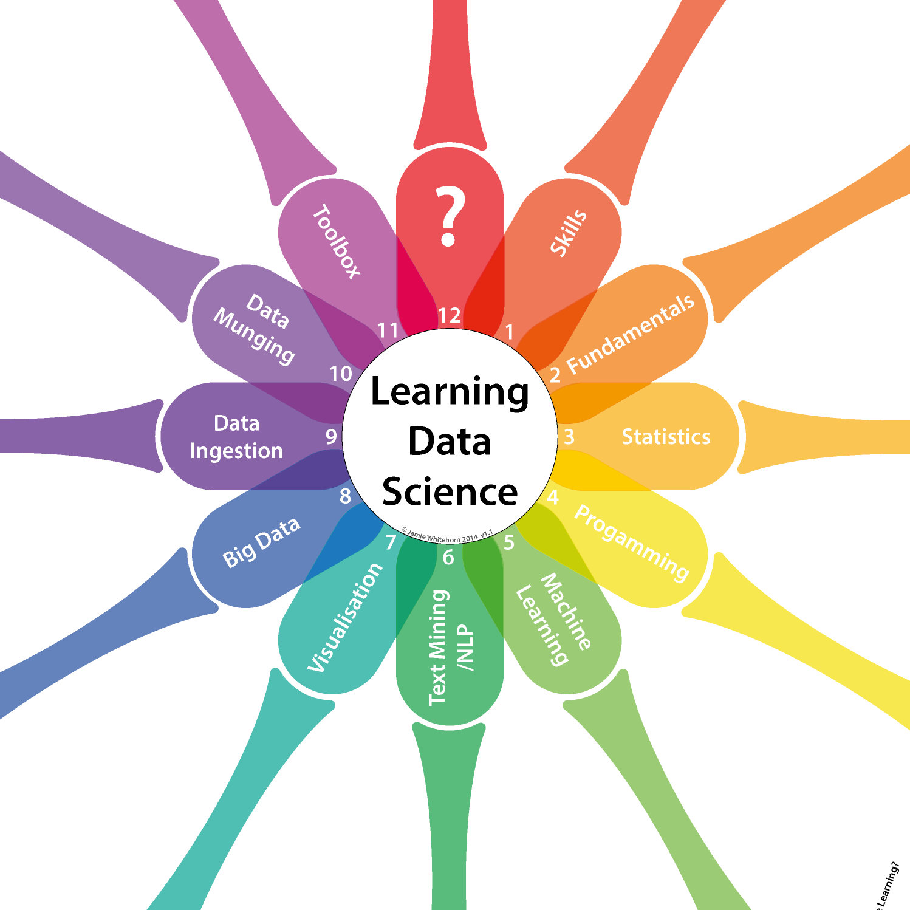
The Data Scientist Skills

Slide 11
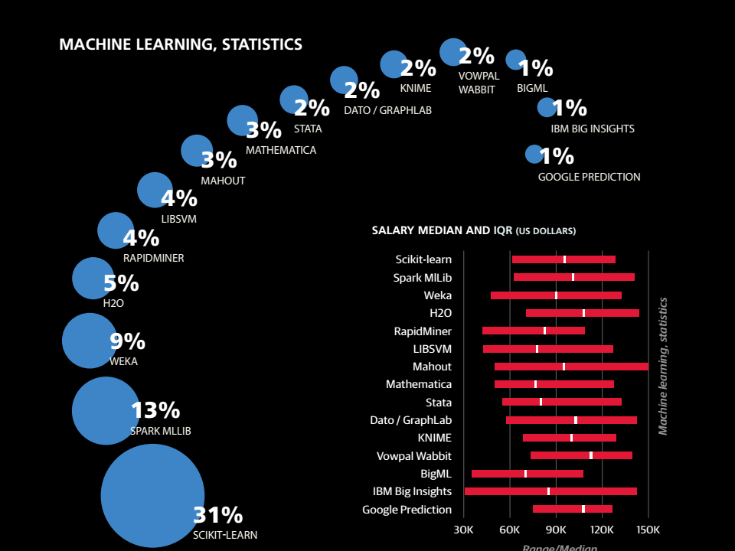
The Data Scientist Skills

Slide 12
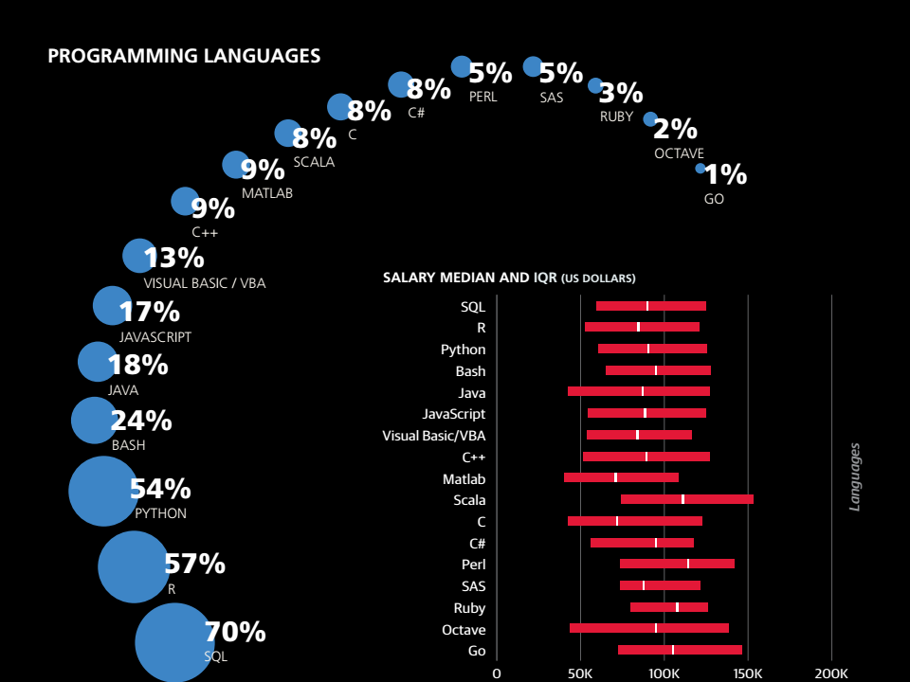
The Data Scientist Skills

Slide 13
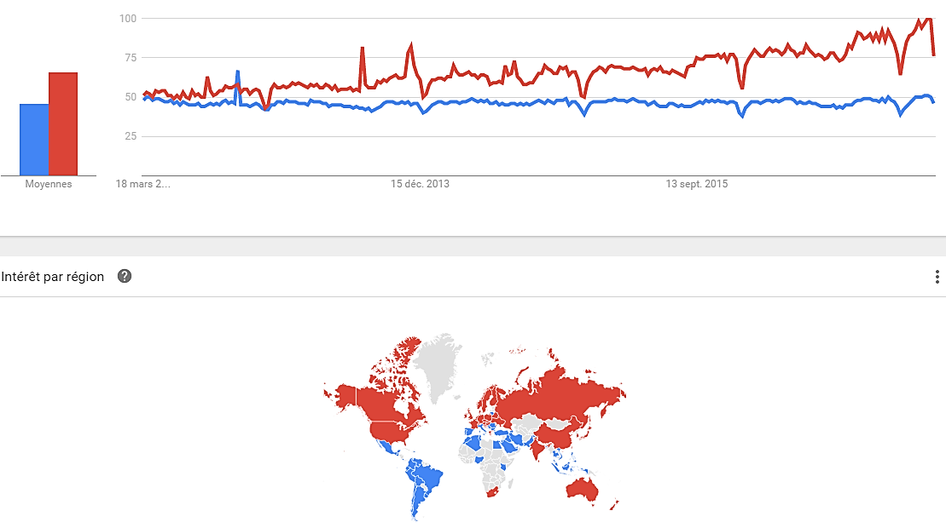
The Data Scientist Skills
Python
R

Slide 14
AGENDA
1
The Data Deluge
2
What is a Data Scientist ?
3
The Data Scientist Skills
4
The Scientific Method
5
The Data Science Process
6
Tools
7
Books
La force de l’engagement^{MD}
Notes:
14

Slide 15
The Scientific Method
Observations
Theories
Hypothesis
Data to Test Predictions
Develop Testable Predictions
Refine, Alter, Expand or Reject Hypothesis

Slide 16
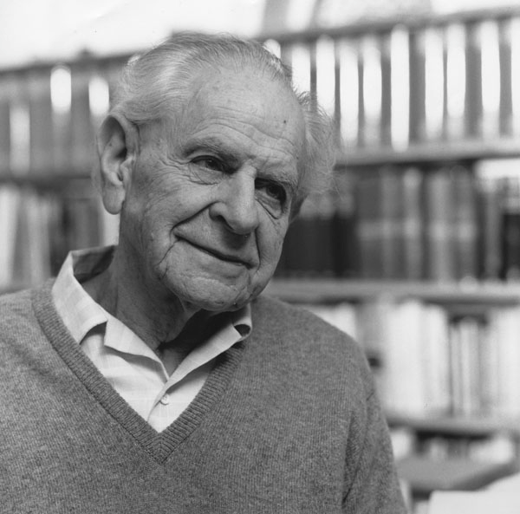
The Scientific Method
Falsicationisme :
Le scientifique doit produire des hypothèses réfutables. La réfutabilité (ou falsifiabilité) est la possibilité de mener une expérience qui démontrerait qu’une affirmation est fausse.
Karl Popper
La logique de la découverte scientifique
(1973)

Slide 17
AGENDA
1
The Data Deluge
2
What is a Data Scientist ?
3
The Data Scientist Skills
4
The Scientific Method
5
The Data Science Process
6
Tools
7
Books
La force de l’engagement^{MD}
Notes:
17

Slide 18

The Data Science Process
Clean Dataset
Exploratory Analysis
Models & Algorithms
Data Processing
Raw Data Collected
Data Product
Communicate Visualize Report

Slide 19
AGENDA
1
The Data Deluge
2
What is a Data Scientist ?
3
The Data Scientist Skills
4
The Scientific Method
5
The Data Science Process
6
Tools
7
Books
La force de l’engagement^{MD}
Notes:
19

Slide 20



Tools
Sublime Text editor
Git
Python 2.7

Slide 21
AGENDA
1
The Data Deluge
2
What is a Data Scientist ?
3
The Data Scientist Skills
4
The Scientific Method
5
The Data Science Process
6
Tools
7
Books
La force de l’engagement^{MD}
Notes:
21

Slide 22
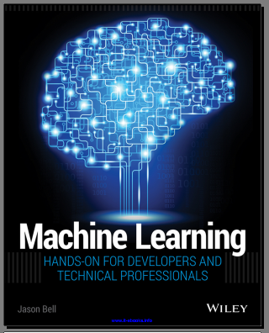
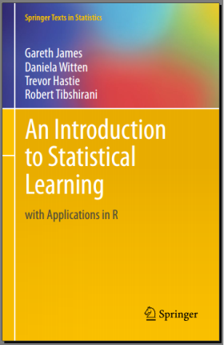
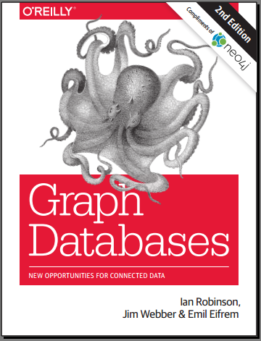
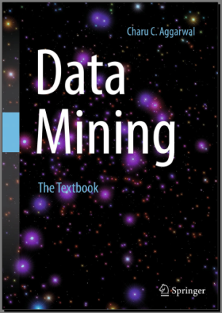
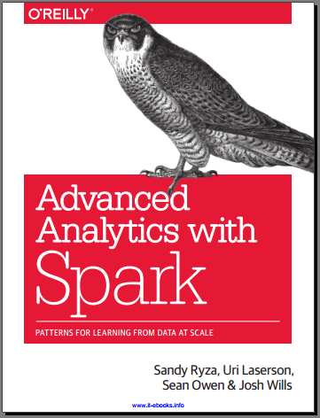
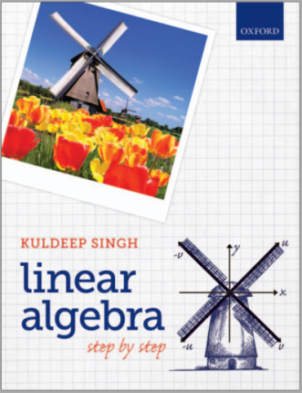
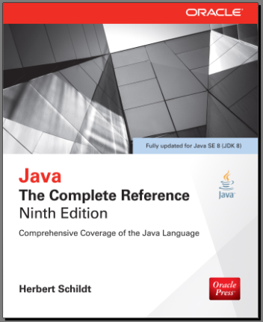
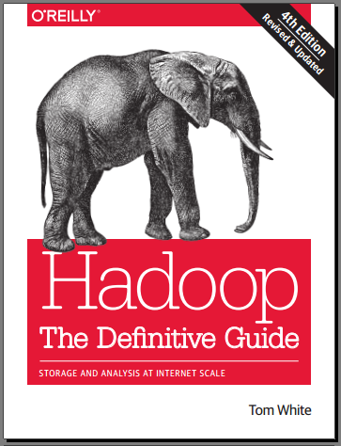
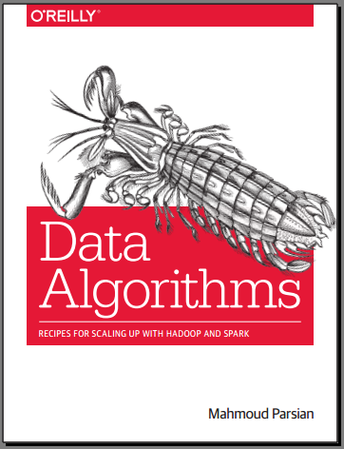
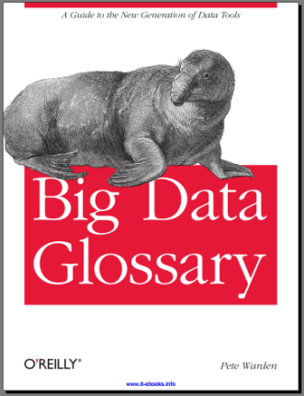
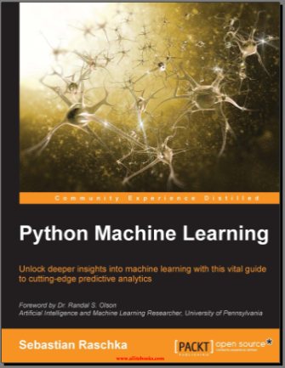
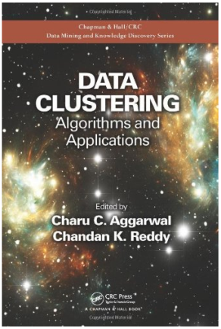
Books

Slide 23

AGENDA
1
The Data Deluge
2
What is a Data Scientist ?
3
The Data Scientist Skills
4
The Scientific Method
5
The Data Science Process
6
Tools
7
Books
La force de l’engagement^{MD}
Notes:
23

Slide 24
Programme
CoursDataScience.git
|
+-Les_bases_du_language_Pyhton.ipynb
|
+-Data_Preparation.ipynb
|
+-Data_Visualisation.ipynb
|
+-Machine_Learning.ipynb
|
+-data/
|
+-best_selling_models.xlsx
|
+-carsdata_features.csv
|
+-carsdata4.json

